Slide 1


Evaluation Scheme

Slide 2

Syllabus

Slide 3
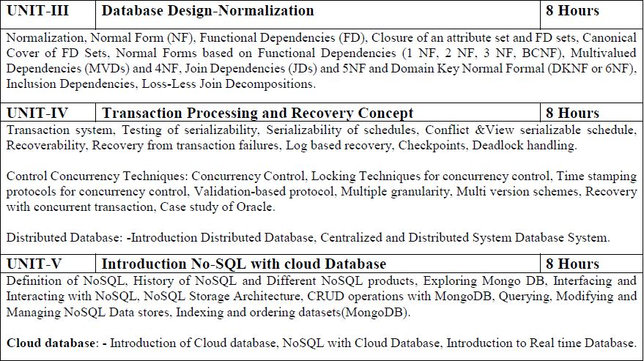
Syllabus

Slide 4

Syllabus of Unit 2
Normalization, Normal Form (NF), Functional Dependencies (FD), Closure of an attribute set and FD sets, Canonical Cover of FD Sets, Normal Forms based on Functional Dependencies (1 NF, 2 NF, 3 NF, BCNF), Multivalued Dependencies (MVDs) and 4NF, Join Dependencies (JDs) and 5NF and Domain Key Normal Formal (DKNF or 6NF), Inclusion Dependencies, Loss-Less Join Decompositions.

Slide 5

Branch wise Applications
There are various application of DBMS in different fields like Railway Reservation System, Library Management System, Banking, Universities and colleges, Credit card transactions etc

Slide 6

Course Objective
Present an introduction to database management systems, with an emphasis on how to organize, maintain and retrieve - efficiently, and effectively - information from a DBMS.
Differentiate between database system and file system.
Knowledge of the different models like database modeling, relational, hierarchical and network models.
Explain basic issues of transaction processing and concurrency control.

Slide 7

Course Outcome
S. NO. | Course Outcomes | Blooms’ Taxonomy
1 | Apply knowledge of database for real life applications. | K3
2 | Apply query processing techniques to automate the real time problems of databases. | K3, K4
3 | Identify and solve the redundancy problem in database tables using normalization | K2, K3
4 | Understand the concepts of transactions, their processing so they will familiar with broad range of database management issues including data integrity, security and recovery. | K2, K4
5 | Design, develop and implement a small database project using database tools. | K3, K6

Slide 8
Program Outcomes (POs)
Engineering Graduates will be able to:
1. Engineering knowledge: Apply the knowledge of mathematics, science, engineering fundamentals, and an engineering specialization to the solution of complex engineering problems.
2. Problem analysis: Identify, formulate, review research literature, and analyze complex engineering problems reaching substantiated conclusions using first principles of mathematics, natural sciences, and engineering sciences.
3. Design/development of solutions: Design solutions for complex engineering problems and design system components or processes that meet the specified needs with appropriate consideration for the public health and safety, and the cultural, societal, and environmental considerations.
4. Conduct investigations of complex problems: Use research-based knowledge and research methods including design of experiments, analysis and interpretation of data, and synthesis of the information to provide valid conclusions.

Slide 9
Program Outcomes (POs)
Contd..
5. Modern tool usage: Create, select, and apply appropriate techniques, resources, and modern engineering and IT tools including prediction and modeling to complex engineering activities with an understanding of the limitations.
6. The engineer and society: Apply reasoning informed by the contextual knowledge to assess societal, health, safety, legal and cultural issues and the consequent responsibilities relevant to the professional engineering practice.
7. Environment and sustainability: Understand the impact of the professional engineering solutions in societal and environmental contexts, and demonstrate the knowledge of, and need for sustainable development.
8. Ethics: Apply ethical principles and commit to professional ethics and responsibilities and norms of the engineering practice.

Slide 10
Program Outcomes (POs)
Contd..
9. Individual and team work: Function effectively as an individual, and as a member or leader in diverse teams, and in multidisciplinary settings.
10. Communication: Communicate effectively on complex engineering activities with the engineering community and with society at large, such as, being able to comprehend and write effective reports and design documentation, make effective presentations, and give and receive clear instructions.
11. Project management and finance: Demonstrate knowledge and understanding of the engineering and management principles and apply these to one’s own work, as a member and leader in a team, to manage projects and in multidisciplinary environments.
12. Life-long learning: Recognize the need for, and have the preparation and ability to engage in independent and life-long learning in the broadest context of technological change.

Slide 11
COs and POs Mapping
 | PO1 | PO2 | PO3 | PO4 | PO5 | PO6 | PO7 | PO8 | PO9 | PO10 | PO11 | PO12
1 | 2 | 2 | 3 | 3 | 3 | 2 | 3 | 2 | 2 | 2 | 2 | 3
2 | 3 | 3 | 3 | 2 | 2 | 2 | 2 | 2 | 2 | 2 | 2 | 3
3 | 2 | 3 | 3 | 3 | 3 | 2 | 2 | 2 | 2 | 2 | 2 | 2
4 | 2 | 3 | 2 | 2 | 2 | 2 | 2 | 2 | 2 | 3 | 2 | 2
5 | 2 | 3 | 2 | 2 | 2 | 3 | 2 | 2 | 3 | 2 | 2 | 2
AVG | 2.20 | 2.80 | 2.60 | 2.40 | 2.40 | 2.20 | 2.20 | 2.00 | 2.20 | 2.20 | 2.00 | 2.40

Slide 12
Program Specific Outcomes
On successful completion of graduation degree the Computer Science & Engineering graduates will be able to:
PSO1: | Work as a software developer, database administrator, tester or networking engineer for providing solutions to the real world and industrial problems. ​
PSO2: | Apply core subjects of information technology related to data structure and algorithm, software engineering, web technology, operating system, database and networking to solve complex IT problems. ​
PSO3: | Practice multi-disciplinary and modern computing techniques by lifelong learning to establish innovative career.
PSO4: | Work in a team or individual to manage projects with ethical concern to be a successful employee or employer in IT industry.

Slide 13
COs and PSOs Mapping
 | Program Specific Outcomes
 | PSO1 | PSO2 | PSO3 | PSO4
1 | 3 | 1 | 3 | 1
2 | 3 | 1 | 3 | 1
3 | 3 | 1 | 3 | 1
4 | 3 | 1 | 3 | 1
5 | 3 | 1 | 3 | 1
AVG | 3.00 | 1.00 | 3.00 | 1.00

Slide 14
Program Educational Objectives (PEOs)
PEO1: Able to apply sound knowledge in the field of information technology to fulfill the needs of IT industry.
PEO2: Able to design innovative and interdisciplinary systems through latest digital technologies.
PEO3: Able to inculcate professional ethics, team work and leadership for serving the society.
PEO4: Able to inculcate lifelong learning in the field of computing for successful career in organizations and R&D sectors.

Slide 15
Result Analysis
Subject Result: 100%
Faculty Result: 100%

Slide 16

End Semester Question Paper Template

Slide 17
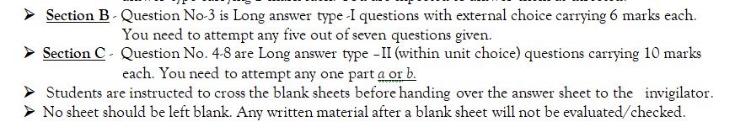
End Semester Question Paper Template

Slide 18

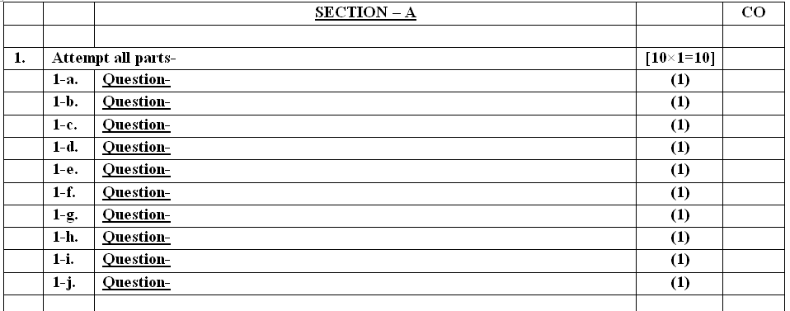
End Semester Question Paper Template

Slide 19
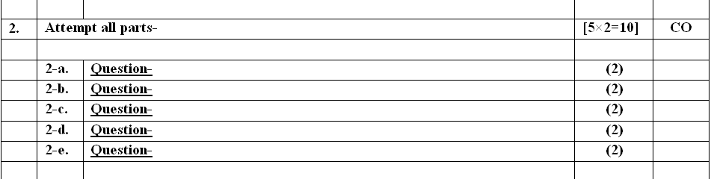
End Semester Question Paper Template

Slide 20
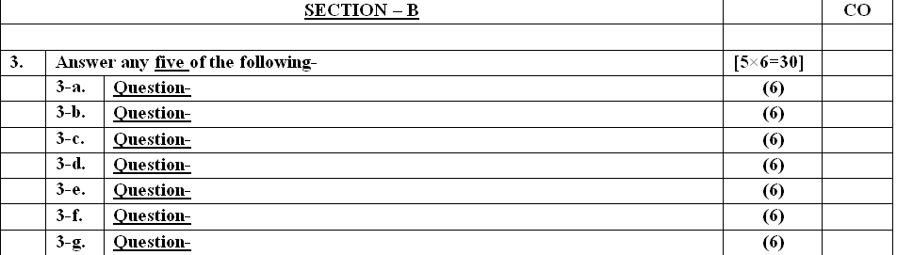
End Semester Question Paper Template

Slide 21

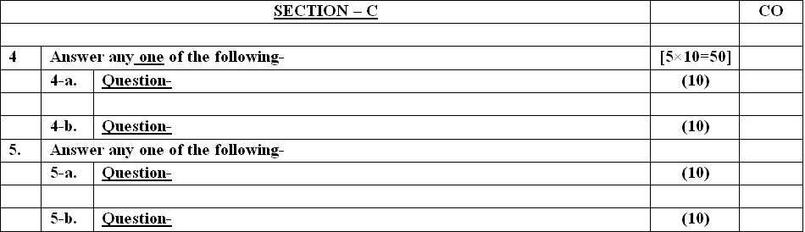
End Semester Question Paper Template

Slide 22
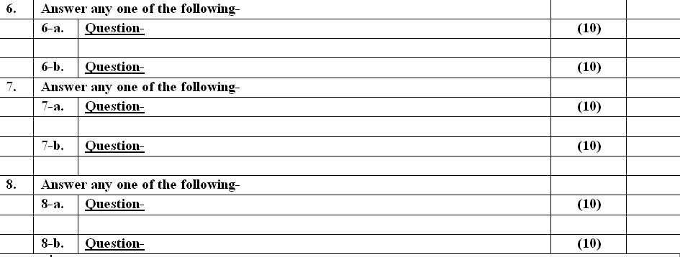
End Semester Question Paper Template

Slide 23
Prerequisite and Recap
A good background in DBMS fundamentals is required.
Students should be comfortable with the relational model, SQL, and the basic functions of database systems.
The proper understanding of data structures and algorithms will help you to understand the DBMS quickly.
Recap
In last unit we studied about
Relational Data Model
Relational Algebra Query
Relational Calculus Query
Structured Query Language

Slide 24
Brief Introduction about Subject
A database management system (DBMS) refers to the technology for creating and managing databases. DBMS is a software tool to organize (create, retrieve, update, and manage) data in a database.
The main aim of a DBMS is to supply a way to store up and retrieve database information that is both convenient and efficient. By data, we mean known facts that can be recorded and that have embedded meaning.
Usually, people use software such as DBASE IV or V, Microsoft ACCESS, or EXCEL to store data in the form of a database.
A datum is a unit of data. Meaningful data combined to form information. Hence, information is interpreted data - data provided with semantics. MS. ACCESS is one of the most common examples of database management software.

Slide 25
Brief Introduction about Subject
Video Links:
https://www.youtube.com/watch?v=kBdlM6hNDAE&list=PLxCzCOWd7aiFAN6I8CuViBuCdJgiOkT2Y
https://www.youtube.com/watch?v=3EJlovevfcA&list=PLxCzCOWd7aiFAN6I8CuViBuCdJgiOkT2Y&index=2

Slide 26
UNIT –III
Database Design-Normalization
Normalization , Normal Form (NF)
Functional Dependencies (FDs)
Closure of an attribute set and FD sets
Canonical Cover of FD Sets
Normal Forms based on Functional Dependencies
1 NF,2 NF ,3 NF,BCNF
Multivalued Dependencies (MVDs) and 4NF
Join Dependencies (JDs) and 5NF
Domain Key Normal Formal (DKNF or 6NF)
Inclusion Dependencies
Loss-Less Join Decompositions
Book References:
1. Korth, Silbertz, Sudarshan,” Database Concepts”, McGraw Hill
2. Date C J, “An Introduction to Database Systems”, Addision Wesley
3. Elmasri, Navathe, “ Fundamentals of Database Systems”, Addision Wesley
4.Bipin C. Desai, “ An Introduction to Database Systems”, Galgotia Publications

Slide 27
Unit Objective
Students will be able to learn Functional dependency that is a relationship that exists when one attribute uniquely determines another attribute.
Normalization to minimizing redundancy from a relation or set of relations. It deals with insertion, deletion, and update anomalies. So, it helps to minimize the redundancy in relations that are used to eliminate or reduce redundancy in database tables to create a good database.

Slide 28
Topic 1 objective
Informal Design Guidelines for Relational Databases
1.1Semantics of the Relation Attributes
1.2 Redundant Information in Tuples and Update Anomalies
1.3 Null Values in Tuples
1.4 Spurious Tuples
Summary of Informal database Design

Slide 29
1.1 Semantics of the Relation Attributes (CO3)
Whenever we group attributes to form a relation schema, we assume that attributes belonging to one relation have certain real-world meaning and a proper interpretation associated with them.
The semantics of a relation refers to its meaning resulting from the interpretation of attribute values in a tuple.
GUIDELINE 1: Informally, each tuple in a relation should represent one entity or relationship instance.
Attributes of different entities should not be mixed in the same relation
Only foreign keys should be used to refer to other entities.
Entity and relationship attributes should be kept apart as much as possible.
Design a schema that can be explained easily relation by relation. The semantics of attributes should be easy to interpret.

Slide 30
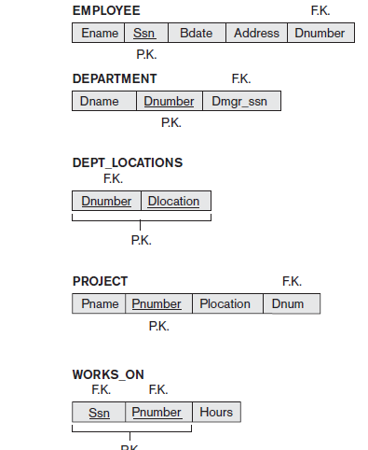
A simplified COMPANY relational database schema (CO3)

Slide 31
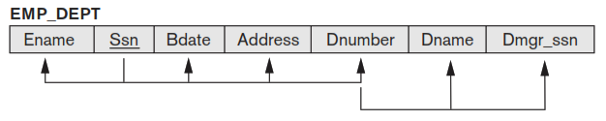
Examples of Violating Guideline 1 (CO3)
Attributes of different entities should not be mixed in the same relation
Informally, each tuple in a relation should represent one entity or relationship instance.
Design a schema that can be explained easily relation by relation. The semantics of attributes should be easy to interpret.

Slide 32
1.2 Redundant Information in Tuples and Update Anomalies (CO3)
1.2. A :- Redundant Information in Tuples
One goal of schema design is to minimize the storage space used by the base relations (and hence the corresponding files). Grouping attributes into relation schemas has a significant effect on storage space.

Slide 33
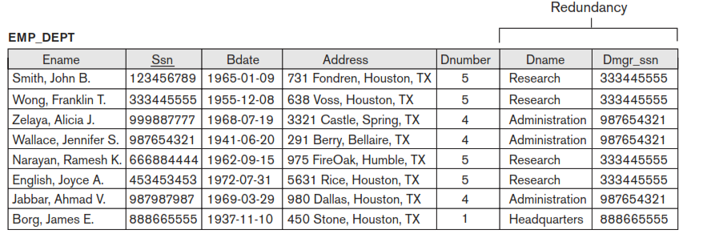
Redundant Information in Tuples (CO3)
Mixing attributes of multiple entities may cause problems.
1. Information is stored redundantly wasting storage, compare the space used by the two base relations EMPLOYEE and DEPARTMENT in with that for an EMP_DEPT base relation . (Wastage of Space by Emp_Dept)

Slide 34
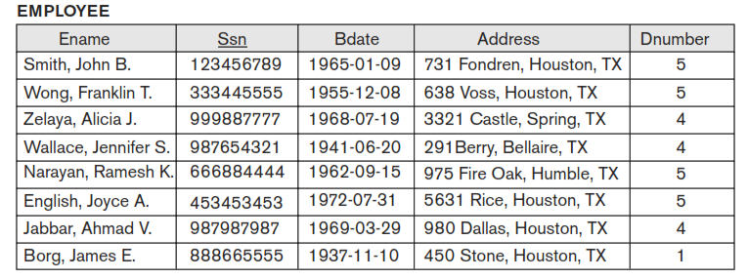
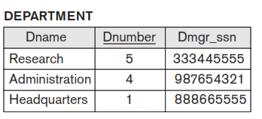
1.2 A. Redundant Information in Tuples (CO3)
Example :- Good database Design Approach

Slide 35

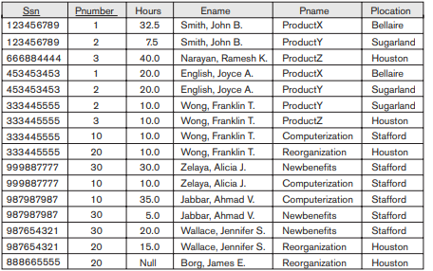
Problems with update anomalies (CO3)
Update Anomaly:- An update anomaly is a data inconsistency that results from data redundancy and a partial update.
Consider the relation:
Update Anomaly: Changing the name of project number 1 from “ProductX” to “ProductABC” may cause this update to be made for all n employees working on project 1.

Slide 36
Problems with update anomalies (CO3)
Problems with update anomalies
Insertion anomalies
Deletion anomalies
Modification anomalies

Slide 37
Insertion anomalies (CO3)
1. To insert a new employee tuple into EMP_DEPT, we must include either the attribute values for the department that the employee works for, or NULLs (if the employee does not work for a department as yet).
Example
2. But, It is difficult to insert a new department that has no employees as yet in the EMP_DEPT relation. The only way to do this is to place NULL values in the attributes for employee. This violates the entity integrity for EMP_DEPT because its primary key Ssn cannot be null.

Slide 38
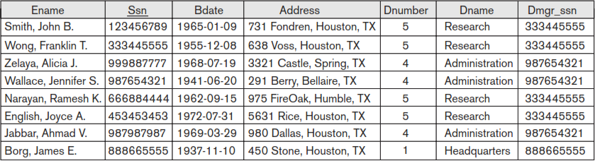
Deletion Anomalies (CO3)
The problem of deletion anomalies is related to the second insertion anomaly situation just discussed. If we delete from table EMP_DEPT an employee tuple that happens to represent the last employee working for a particular department, the information concerning that department is lost accidentally from the database.
Example :- Emp_Dept
When a department is deleted, it will result in deleting all the employees who work only on that project. Alternately, if an employee is the sole employee on a department, deleting that employee would result in deleting the corresponding project.

Slide 39
Modification anomalies (CO3)
In EMP_DEPT, if we change the value of one of the attributes of a particular department—say, the manager of department 5—we must update the tuples of all employees who work in that department;
otherwise, the database will become inconsistent. If we fail to update some tuples, the same department will be shown to have two different values for manager in different employee tuples, which would be wrong.
Example :- Emp_Dept

Slide 40
Guideline to Redundant Information in Tuples and Update Anomalies(CO3)
It is easy to see that these three anomalies are undesirable and cause difficulties to maintain consistency of data as well as require unnecessary updates that can be avoided; hence, we can state the next guideline as follows:-
Guideline 2. Design the base relation schemas so that no insertion, deletion, or modification anomalies are present in the relations. If any anomalies are present, note them clearly and make sure that the programs that update the database will operate correctly.

Slide 41
No Anomalies & No redundancy Exists (CO3)

Slide 42
1.3 Null Values in Tuples(CO3)
In some schema designs we may group many attributes together into a “fat” relation. If many of the attributes do not apply to all tuples in the relation, we end up with many NULLs in those tuples.
Example
This can waste space at the storage level and may also lead to problems with understanding the meaning of the attributes and with specifying JOIN operations at the logical level.
Another problem with NULLs is how to account for them when aggregate operations such as COUNT or SUM are applied
Note :- If NULL values are present, the results may become unpredictable.

Slide 43
Guideline Null Values in Tuples(CO3)
GUIDELINE 3: As far as possible, avoid placing attributes in a base relation whose values may frequently be NULL. If NULLs are unavoidable, make sure that they apply in exceptional cases only and do not apply to a majority of tuples in the relation.
Relations should be designed such that their tuples will have as few NULL values as possible (wastage of space in storage level and difficulties in JOIN operation with NULL values).
Attributes that are NULL frequently could be placed in separate relations (with the primary key).

Slide 44
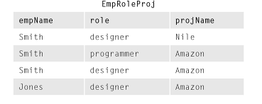
1.4 Generation of Spurious Tuples(CO3)
A spurious tuple is, basically, a record in a database that gets created when two tables are joined badly (before or after decomposition). In databases, spurious tuples are created when two tables are joined on attributes that are neither primary keys nor foreign keys.
Example :-

Slide 45
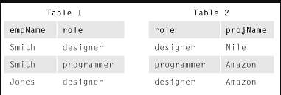
1.4 Generation of Spurious Tuples(CO3)
The two relations Table1 and Table2 as the base relations of EMPRoleProj, is not a good schema design.
Problem is if a Natural Join is performed on the above two relations it produces more tuples than original set of tuples in EMPRoleProj.
These additional tuples that were not in EMPRoleProj are called spurious tuples because they represent spurious or wrong information that is not valid.
This is because the role attribute which is used for joining is neither a primary key, nor a foreign key in either Table1 and Table2.

Slide 46
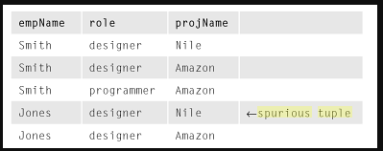
Example with spurious tuple(CO3)
Result of applying NATURAL JOIN to the tuples in Table1 and Table2,just for EMPRoleProj with {Jones, Designer ,Nile } generated spurious tuples.

Slide 47
1.4 Generation of Spurious Tuples(CO3)
Guideline 4
Design relation schemas so that they can be joined with equality conditions on attributes that are appropriately related (primary key, foreign key) pairs in a way that guarantees that no spurious tuples are generated.
Avoid relations that contain matching attributes that are not (foreign key, primary key) combinations because joining on such attributes may produce spurious tuples.
Note :- This informal guideline obviously needs to be stated more formally. we discuss a formal condition called the non-additive (or lossless) join property that guarantees that certain joins do not produce spurious tuples.

Slide 48
Summary of Informal database Design(CO3)
The problems we pointed out, which can be detected without additional tools of analysis, are as follows:-
Anomalies that cause redundant work to be done during insertion into and modification of a relation, and that may cause accidental loss of information during a deletion from a relation.
Waste of storage space due to NULLs and the difficulty of performing selections, aggregation operations, and joins due to NULL values.
Generation of invalid and spurious data during joins on base relations with matched attributes that may not represent a proper (foreign key, primary key) relationship

Slide 49
Summary of Informal database Design(CO3)
we present informal concepts and theory that may be used to define the goodness and badness of individual relation schemas more precisely.
Now we discuss functional dependency as a tool for analysis.

Slide 50
Faculty Video Links, Youtube & NPTEL Video Links and Online Courses Details
You tube /other Video Links
https://nptel.ac.in/courses/106/104/106104135/
https://nptel.ac.in/courses/106106220/
https://www.youtube.com/watch?v=1057YmExS-I

Slide 51
Weekly Assignment 1.1
What do you mean by BCNF ? Why it is used and how it differ from 3 NF ? CO3
Discuss the various normal forms in normalization with suitable examples?
Why is concurrency control needed? Explain lost update, Inconsistent retrievals and uncommitted dependency anomalies. CO3
Explain the Codd’s Rule in detail. CO3
Explain Normalization with example. CO3
What are the rules of 1NF,2NF,3NF. CO3
Discuss Boyce Codd Normalization Form. CO3

Slide 52
Recap
1.1Semantics of the Relation Attributes
1.2 Redundant Information in Tuples and Update Anomalies
1.3 Null Values in Tuples
1.4 Spurious Tuples

Slide 53
Topic 2 Objective
Functional dependency
Types of Functional dependency

Slide 54
2.1 Functional Dependencies(CO3)
We now introduce a formal tool for analysis of relational schemas that enables us to detect and describe some of the above-mentioned problems in precise terms.
The single most important concept in relational schema design theory is that of a functional dependency.
Important points for FD are
Functional dependencies is a constraint between 2 sets of attributes
Functional dependencies (FDs) are used to specify formal measures of the "goodness" of relational schema designs
FDs and keys are used to define normal forms for relations
FDs are constraints that are derived from the meaning and interrelationships of the data attributes.

Slide 55
Definition of Functional Dependency(CO3)
A functional dependency, denoted by X → Y, between two sets of attributes X and Y that are subsets of R specifies a constraint on the possible tuples that can form a relation state r of R.
The constraint is that, for any two tuples t1 and t2 in r that have t1[X] = t2[X], they must also have t1[Y] = t2[Y].
This means that the values of the Y component of a tuple in r depend on, or are determined by, the values of the X component;
Alternatively, the values of the X Component of a tuple uniquely (or functionally) determine the values of the Y component. We also say that there is a functional dependency from X to Y, or that Y is functionally dependent on X.

Slide 56
FD on Key and Non key Attribute(CO3)
Functional dependency exists between the primary key and non-key attribute within a table.
FD on Non Key Attribute
Thus, X functionally determines Y in a relation schema R if, and only if, whenever two tuples of r(R) agree on their X-value, they must necessarily agree on their Y-value.
FD on Key Attribute
If a constraint on R states that there cannot be more than one tuple with a given X-value in any relation instance r(R)—that is, X is a candidate key of R—this implies that X → Y for any subset of attributes Y of R (because the key constraint implies that no two tuples in any legal state r(R) will have the same value of X). If X is a candidate key of R, then X → R.
If X → Y in R, this does not say whether or not Y → X in R.

Slide 57
Example
Rollno | Name | Marks
1 | A | 10
2 | B | 20
1 | A | 10
4 | B | 20
5 | C | 30
6 | D | 30

Slide 58
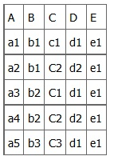
Example
Let us Consider the following table of data r(R) of the relation schema R(ABCDE) shown in
Since the values of A are unique (a1, a2, a3, etc.), it follows from the FD definition that:-
A → B, A → C, A → D, A → E,
Means A attribute uniquely identifies the B,C,D,E attribute of R relation because if we know the A we can tell the B,C,D,E associated with it.
This can be also write as A →BCDE.
From our understanding of primary keys, A is a primary key.

Slide 59
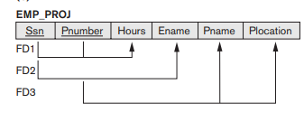
Diagrammatic notation for displaying FD(CO3)
Consider the relation schema EMP_PROJ from the semantics of the attributes and the relation, we know that the following functional dependencies should hold:-
a. Pnumber → {Pname, Plocation}
b. Ssn → Ename
c. {Ssn, Pnumber} → Hours
Pnumber uniquely determines Pname and Plocation.
Ssn of an employee uniquely determines the Ename.
Combination of Ssn & Pnumber uniquely determines the Hours

Slide 60
Types of Functional dependency(CO3)
There are mainly two types of Functional Dependency in DBMS.
Following are the types of Functional Dependencies in DBMS:
Trivial Functional Dependency
Non-Trivial Functional Dependency

Slide 61
Trivial Functional Dependency(CO3)
The Trivial dependency is a set of attributes which are called a trivial if the set of attributes are included in that attribute.
So, X -> Y is a trivial functional dependency if Y is a subset of X.
Let’s understand with a Trivial Functional Dependency Example.
For example:
{Emp_id, Emp_name} -> Emp_id is a trivial functional dependency as Emp_id is a subset of {Emp_id,Emp_name}.
Emp_id | Emp_name
AS555 | Harry
AS811 | George
AS999 | Kevin

Slide 62
Non-Trivial Functional Dependency(CO3)
Non Trivial Functional Dependency in DBMS
Functional dependency which also known as a nontrivial dependency occurs when A->B holds true where B is not a subset of A. In a relationship, if attribute B is not a subset of attribute A, then it is considered as a non-trivial dependency.
Example:
(Company} -> {CEO} (if we know the Company, we knows the CEO name)
But CEO is not a subset of Company, and hence it’s non-trivial functional dependency.
Company | CEO | Age
Microsoft | Satya Nadella | 51
Google | Sundar Pichai | 46
Apple | Tim Cook | 57

Slide 63
Recap
Functional dependency
Types of Functional dependency

Slide 64
Topic 3 Objective
Inference rules

Slide 65
Inference Rules for Functional Dependencies(CO3)
An inference rule is an assertion that we can apply to a set of functional dependencies to derive other functional dependencies.
We denote by F the set of functional dependencies that are specified on relation schema R.
Inference rules are sound meaning that they are an immediate consequence of the definition of FD and that only FD that can be derived from a relation from a given set of FD using them to true.
So, inference rules can be used to find all the derived FD’s logically by a set of FD is true and complete.

Slide 66
Definition(CO3)
Definition:
An FD X → Y is inferred from or implied by a set of dependencies F specified on R if X → Y holds in every legal relation state r of R; that is, whenever r satisfies all the dependencies in F, X → Y also holds in r.
Inference rules basically based on Armstrong axiom.
Armstrong Axiom basic inference rules are :-
1. IR1 (reflexive rule) : If X ⊇ Y, then X →Y.
2. IR2 (augmentation rule) : {X → Y} |= XZ → YZ.
3. IR3 (transitive rule): {X → Y, Y → Z} |= X → Z.
IR1, IR2, IR3 form a sound and complete set of inference rules

Slide 67
Armstrong Axiom Rules(CO3)
There are three other inference rules that follow from IR1, IR2 and IR3.
They are as follows:
4. IR4 (decomposition, or projective, rule): {X → YZ} |=X → Y,
X →Z
5. IR5 (union, or additive, rule): {X → Y, X → Z} |=X → YZ.
6 . IR6 (pseudotransitive rule): {X → Y, WY → Z} |=WX → Z.
7 . IR7 (composition rule): {X → Y, Z → W} |=XZ → YW.
Note:- Rules from IR1 to IR3 are known as Armstrong Axiom rules. These rules are mainly used in FD to find complete set of all possible dependencies.

Slide 68
Exercise 3.1
Prove or disprove the following inference rules:-
{W→Y,X→Z} |= {WX→Y}
{X→Z,Y →Z} |= {X→Y}
{X→Y,Y →W} |= {XZ→YW}

Slide 69
Exercise 3.2
Prove or disprove the following inference rules
{W→Y,X→Z} |= {WX→Y}
{X→Y,X→W,WY→Z} |= {X→Z}
{X→Y} |= {X→YZ}
{X→Y, Z →Y} |= {XZ→Y}

Slide 70
Question(CO3)
Let us consider the Universal relation schema R = ( A, B, C, G, H, I ) and the set of functional dependencies F ={ A → B, A → C, CG → H, CG → I , B → H}.
Determines the other FD’s from given set of FD F.
Answer:-
Given F= { A → B, A → C, CG → H, CG → I , B → H}.
Since A → B and B → H hold, we apply the transitivity rule that A → H
Since CG → H and CG → I , the union rule implies that CG → HI.
Since A → C and CG → I , the pseudo-transitivity rule implies that AG → I holds
Since A → B and A→ C hold, we apply the union rules that A → BC
All possible FD are:-
F’= { A → B, A → C, CG → H, CG → I , B → H, A → H, CG → HI ,A →BC, AG → I }.

Slide 71
Conti………… (CO3)
Note:-
Armstrong axioms are complete. As for a given set F of functional dependencies, all FD implied by F can be inferred by using rules IR1 through IR3.
Armstrong axiom are also sound as to no additional FD or incorrect FD’s can be deduced from F by using inference rules.

Slide 72
Recap
Inference rules

Slide 73
Topic 4,5 Objective
Closure of Attribute set.
Definitions of Keys
Find the super key and candidate key from FD

Slide 74
Closure of a Attribute set(CO3)
After finding a set of FD’s that are hold on a relation the next step is to find super key and candidate key for a relation and,
Also to test whether a set X is a super key, we must devise an algorithm for computing the set of attributes functionally determined by X.

Slide 75
Algorithm for Closure of a Attribute set(CO3)
The set of attribute that are functionally dependent on the attribute X is called attribute closure of X and it can be represented by X^{+.}
Or
For each such set of attributes X, we determine the set X⁺ of attributes that are functionally determined by X based on F;
X⁺ is called the closure of X under F.
Algorithm :- Determining X⁺, the Closure of X under F .
Input: A set F of FDs on a relation schema R, and a set of attributes X, which is a subset of R.
X⁺ := X;
repeat
old X⁺ := X⁺;
for each functional dependency Y → Z in F do
if X⁺ ⊇ Y then X⁺ := X⁺ ∪ Z;
until (X⁺ = old X⁺);

Slide 76
Example
Question 1:-
To compute the closure for relation schema R ={A,B,C,G,H,I} and F= {A → B,A → C,CG → H, CG → I,B → H,C → G).
Find the closure of A under F . Or {A⁺ =}
Question 2:-
To compute the closure for relation schema R ={A,B,C,D,E} and F= {A → BC,CD → E,B → D, E → A}.
Find the closure of A and CD under F . or {A⁺ =} and { CD ⁺ =}

Slide 77
Definitions of Keys and Attributes Participating in Keys
A super key of a relation schema R = {A1, A2, … , An} is a set of attributes S ⊆ R with the property that no two tuples t1 and t2 in any legal relation state r of R will have t1[S] = t2[S].
If a relation schema has more than one key, each is called a candidate key.
One of the candidate keys is designated to be the primary key, and the others are called secondary keys. In a practical relational database, each relation schema must have a primary key.
If no candidate key is known for a relation, the entire relation can be treated as a default super key.
An attribute of relation schema R is called a prime attribute of R if it is a member of some candidate key of R.
An attribute is called nonprime if it is not a prime attribute—that is, if it is not a member of any candidate key.

Slide 78
Find the super key and candidate key from FD(CO3)
Definition :- The set of attribute whose closure of attribute is set of all attribute of a relation called super key of relation and if this is set of minimal of it is called of candidate key.
Formally say ,
Let R is the relation and X is the set of attribute over R.
If X⁺ determines all the attributes of R, then X is said to be super key, or candidate key of R.
To find the candidate key first find all the super key of a relation. (because the candidate key is a minimal set of super key).

Slide 79
Step to find the super key and candidate Key(CO3)
So To identify super key and candidate key, We need to follow some steps,
Compute the closure for the attribute that combination of attribute on The LHS of FD,
If any closure includes all the attribute of given relation, then that can be denoted as a key for the relation(This would be the set of super key and candidate key).
When we indentify the super key using FD’s and it has extraneous attribute in the super key then,
Now applying the given FD and reduced the set of LHS elements
Repeat Step-4,Apply till the of element of the super key when it is not functionally determines all FD, If fail Stop, otherwise
We determines all FD from a exclusive attribute of super key is true is called candidate key

Slide 80
Example
Question 1-
To find the Keys of relation R={A,B,C,D,E} with FD’s F={A →BC,CD →E,E → A,B → D}.
Question 2-
To find the Keys of relation R={A,B,C,D,E,H} with FD’s F={A →BC,CD →E,E → C,C → AEH,AH →D,DH → BC}.

Slide 81
Recap
Closure of Attribute set.
Definitions of Keys
Find the super key and candidate key from FD

Slide 82
Topic 6 Objective
Equivalence set of FD
Minimal cover, Canonical cover of FD

Slide 83
Equivalence Sets of FDs(CO3)
Definition.
A set of functional dependencies F is said to cover another set of functional dependencies E if every FD in E is also in F+; that is, if every dependency in E can be inferred from F; alternatively, we can say that E is covered by F.
Means,
Two sets of FDs F and E are equivalent if:
- every FD in F can be inferred from E, and
- every FD in E can be inferred from F
Hence, F and E are equivalent if F ⁺ = E ⁺
F and E are equivalent if F covers E and E covers F

Slide 84
Step to Equivalence Sets of FDs(CO3)
We can determine whether F covers E by calculating X⁺ with respect to F for each FD X → Y in E,
And then checking whether this X⁺ includes the attributes in Y. If this is the case for every FD in E, then F covers E. We determine whether E and F are equivalent by checking that E covers F and F covers E.
Note
If F and G are the two sets of functional dependencies, then following 3 cases are possible-
If all FDs of E can be derived from FDs present in F, we can say that F ⊃ E.
If all FDs of F can be derived from FDs present in E, we can say that E ⊃ F.
3. If 1 and 2 both are true, F=E.

Slide 85
Example(CO3)
Question 1:-
Let us consider a relation schema R ={A,B,C,D,E} having two functional dependency(FD) set E and F,
E= {A → B, AB → C, D → AC, D → E} and
F = {A → BC, D → AE}
Check wheteher two set are equivalent or not.
Question 2:-
Let us consider a relation schema R ={A,B,C,D,E,H} having two functional dependency(FD) set F and G,
F = {A → C, AC → D, E → AD, E → H}
G = {A → CD, E → AH}
Check wheteher two set are equivalent or not.

Slide 86
Minimal cover, Canonical cover of FD

Slide 87
Need of minimal cover of Functional Dependencies(CO3)
Whenever a user updates database the system must check whether any FD are getting violated in the process, if there is a violation of dependencies in the new database state the system must rollback. If working with a huge set of FD can cause unnecessary added computational time .
Remove the extraneous attribute in FD set and also remove the redundant FD in F and get standard from of FD.
So we can reduce the effort spent in checking for violation by testing a simplified set of FDs, canonical cover comes to play big role for remove redundant FD and find the standard form of FD.

Slide 88
Continue…… (CO3)
A minimal cover of a set of functional dependencies E is a set of functional dependencies F that satisfies the property that every dependency in E is in the closure F ⁺ of F.
In addition, this property is lost if any dependency from the set F is removed; F must have no redundancies in it, and the dependencies in F are in a standard form.

Slide 89
Definition of minimal cover(CO3)
Definition:- An attribute in a functional dependency is considered an extraneous attribute if we can remove it without changing the closure of the set of dependencies.
Formally, given F, the set of functional dependencies, and a functional dependency X → A in F, attribute Y is extraneous in X if Y ⊂ X, and F logically implies (F − (X → A) ∪ { (X − Y) → A } ).
We can formally define a set of functional dependencies F to be minimal if it satisfies the following conditions: -
1. Every dependency in F has a single attribute for its right-hand side.
2. We cannot replace any dependency X → A in F with a dependency Y → A, where Y is a proper subset of X, and still have a set of dependencies that is equivalent to F.
3. We cannot remove any dependency from F and still have a set of dependencies that is equivalent to F.

Slide 90
Algorithm for Minimal cover(CO3)
Algorithm:- Finding a Minimal Cover F for a Set of Functional Dependencies E
Input: A set of functional dependencies E.
1. Set F := E.
2. Replace each functional dependency X → {A1, A2, … , An} in F by the n functional dependencies X →A1, X →A2, … , X → An.
3. For each functional dependency X → A in F for each attribute B that is an element of X if { {F − {X → A} } ∪ { (X − {B} ) → A} } is equivalent to F then replace X → A with (X − {B} ) → A in F.
(* The above constitutes a removal of the extraneous attribute B from X *)
4. For each remaining functional dependency X → A in F if {F − {X → A} } is equivalent to F, then remove X → A from F.
(*This constitutes removal of a redundant functional dependency X → A from F when possible*)

Slide 91
Example(CO3)
Question 1:-
Given a relation schema R = {A,B,C,D,E,F}and a set of functional dependencies F= {AB → C, C → A, BC → D, ACD → B, BE → C, EC → FA,CF → BD, D → E }
To find the minimal cover for above given FD’s.
Question 2:-
Given a relation schema R = {A,B,C,D,E}and a set of functional dependencies F= {A → BC, CD → E,B → D, E → A }
To find the minimal cover for above given FD’s.

Slide 92
Recap
Equivalence set of FD
Minimal cover, Canonical cover of FD

Slide 93
Topic 7 Objective
Definition of Normalization and Normal form
Need of normalization
Practical Use of Normal Forms
Types of Normalization
First Normal Form(INF)
Second Normal Form (2NF)
Third Normal Form (3NF)
BCNF (Boyce Codd Normal Form)
Fourth normal Form (4NF)
Fifth Normal form (5NF)

Slide 94
Definition of Normalization and Normal form(CO3)
Definition :- Normalization is a process of organization the data in database with ensuring well-formed.
Or
The process of decomposing unsatisfactory "bad" relations by breaking up their attributes into smaller relations.
Normal form: Condition using keys and FDs of a relation to certify whether a relation schema is in a particular normal form .

Slide 95
Need of Normalization(CO3)
It is the process of analyzing the given relation schemas based on the FD’s and primary key to achieve the desirable properties are :-
Minimizing redundancy
Eliminates the anomalies(for insuring the integrity and consistency of the data).
Ensuring data dependencies make sense i.e. data is logically stored (all prime attribute in a relation )
Dependent on the primary key (Normalization generally involving splitting existing table into multiple ones).

Slide 96
Practical Use of Normal Forms(CO3)
Normalization is carried out in practice so that the resulting designs are of high quality and meet the desirable properties.
The practical utility of these normal forms becomes questionable when the constraints on which they are based are hard to understand or to detect.
The database designers need not normalize to the highest possible normal form. (usually up to 3NF, BCNF or 4NF).
De normalization: the process of storing the join of higher normal form relations as a base relation—which is in a lower normal form

Slide 97
Content
Normal form
Types of Normalization
First Normal Form(1NF)
Second Normal Form (2NF)
Third Normal Form (3NF)
BCNF (Boyce Codd Normal Form)
Fourth normal Form (4NF)
Fifth Normal form (5NF)

Slide 98
Procedure of Normalization(CO3)
In normalization we use the degree of the normal forms in a relation.
The normal form of a relation refer highest normal form condition that it meets, and hence indicate the degree to which it has been normalized.
The top-down process evaluates each relation against the criteria for normal forms and decomposing relations as necessary - relational design by analysis.
Codd proposed 3 normal forms - first, second, and third. A stronger definition of 3NF—called Boyce-Codd normal form (BCNF) - proposed by Boyce and Codd.
All these normal forms are based on a single analytical tool: the functional dependencies among the attributes of a relation.
Later, a fourth normal form (4NF) and a fifth normal form (5NF) were proposed, based on the concepts of multivalued dependencies and join dependencies

Slide 99
Procedure of Normalization(CO3)
Design the good database relation also consider two other properties.
Lossless join or additive join property – which is guarantee that no spurious tuples are generated after the decomposition to the relation reconstructed.
Dependency preservation property :- it is ensure that each FD’s represented in some individual relation resulting after decomposition.
Note :- In practice INF,2NF and 3NF are enough for database normalization.

Slide 100
1. First Normal Form (1NF) (CO3)
First Normal Form (1NF):- As per the rule of 1NF,A relation cannot hold multiple values in a column. It should hold only atomic values.
Means,
Disallows composite attributes, multivalued attribute in relations;
The first normal form also disallows multivalued attributes that are themselves composite. These are called nested relations because each tuple can have a relation within it.

Slide 101
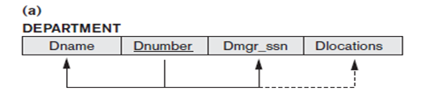
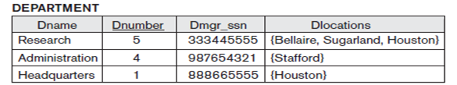
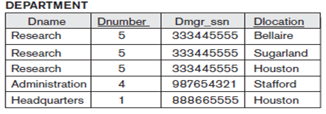
Example Normalization into 1NF(CO3)
1. Let us Consider following relation Schema Department.
2. Sample State of relation schema Department.
3. 1NF version relation Department with redundancy .

Slide 102
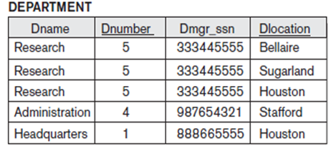
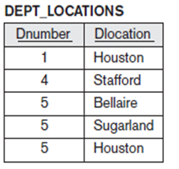
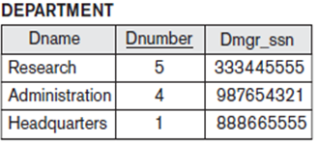
First Normal Form (1NF)(CO3)
Solution:-
Remove the attribute Dlocations from Department relation that violates 1NF and place it in a separate relation DEPT_LOCATIONS with the primary key {Dnumber, Dlocation}. DEPT_LOCATIONS exists for each location of a department. This decomposes the non-1NF relation into 1NF relations.

Slide 103


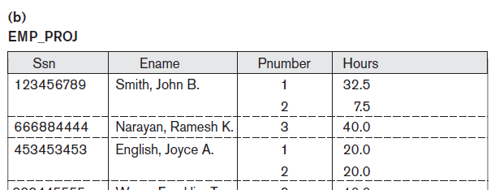
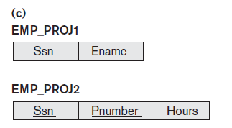
Normalization nested relations into 1NF(CO3)
1. Let us Consider following relation Schema EMP_PROJ.
2. Sample State of relation schema EMP_PROJ.
3. Solution 1NF version relation EMP_PROJ

Slide 104
2. Second Normal Form (2NF)(CO3)
Second Normal Form (2NF) is based on the concept of full functional dependency ,and
It also satisfy the following conditions:-
It is in the First Normal Form.
All non-Key attribute are fully functional dependent on the primary key or candidate key of a relation.
Solution
All partial dependencies are removed to place in another relation.

Slide 105
2. Second Normal Form (2NF)(CO3)
Definition :-
A FD X -> Y is full functional dependency, if removal of any attribute A from X, the dependency does not hold any more.
That is for any attribute A ∈ X,(X-{A}) does not functionally determines Y, else it is partial FD. :- (X-{A}) -> Y(NOT hold )
Examples:-
{SSN, PNUMBER} -> HOURS is a full FD since neither SSN -> HOURS nor PNUMBER -> HOURS hold .
Partial Function Dependency :- A FD X -> Y, is a partial functional dependency if some attribute A ∈ X, can be removed from X and dependency still hold.
A ∈ X, (X-{A}) -> Y(hold )

Slide 106
2. Second Normal Form (2NF)(CO3)
A relation schema R is in second normal form (2NF) if every non-prime attribute A in R is fully functionally dependent on the primary key or candidate key of R.(means all non key attribute cannot be dependent on a subset of the primary key or candidate key ).
Otherwise ,
R can be decomposed into 2NF relations via the process of 2NF normalization .
Note :- The test for 2NF involves testing for functional dependencies whose left-hand side attributes are part of the primary key. If the primary key contains a single attribute, the test need not be applied at all.
If a primary key is not a composite primary key, such case all non key attribute are always fully dependent on the primary key .

Slide 107
Example 2NF (CO3)
Let us Consider the following relation schema EMP_PROJ {SSN,Pnumber,hours,ename,pname,plocation}
with FD Set F=
FD1= {SSN,Pnumber} -> hours
FD2= {SSN} -> ename
FD3={Pnumber} -> {Pname,plocation}
Check for 2NF,if it is not in 2NF then converted into 2NF.(Relation have composite primary key {SSN, Pnumber}).

Slide 108
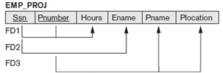
Example 2NF(CO3)
FD1= {SSN,Pnumber} -> hours (Fully Functional dependency)
FD2= {SSN} -> ename (Partial Functional dependency)
Therefore ename is partial dependent on SSN, which is only the part of the primary key. Therefore FD2 is not satisfied second normal form.
FD3={Pnumber} -> {Pname, plocation} (Partial Functional dependency)
{Pname,Plocation } is also partial dependent on Pnumber, which is only the part of the primary key. Therefore FD3 is not satisfied second normal form
FD1= {SSN,Pnumber} -> hours
FD2= {SSN} -> ename
FD3={Pnumber} -> {Pname,plocation}

Slide 109
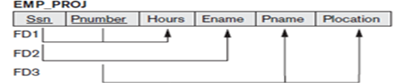



Example(CO3)
Solution :-
To bring relation EMP_PROJ into second normal form, We decompose the relation

Slide 110
3. Third Normal Form (3NF)(CO3)
Definition:-
A relation will be in 3NF if it is in 2NF and not contain any transitive partial dependency.
Means ,
Every Non Prime attribute of a relation must be dependent on the primary key.
Note:- An attribute that is not part of any candidate key is known as non-prime attribute.
Transitive Functional Dependency :- If A->B and B->C are two FDs then A->C is called transitive dependency.

Slide 111
3. Third Normal Form (3NF)(CO3)
A relation schema R is in third normal form (3NF) if it holds atleast one of the following conditions for every FD X -> A holds in R,
X is a super key or,
A is a prime attribute of R. (each element of A is part of some candidate key).
NOTE: Boyce-Codd normal form disallows condition (b) above
(LHS must be super key or candidate key or RHS is a prime attribute).
So any FD’s in relation Schema R must be satisfied at least one above condition otherwise all transitive FD’s non key attribute are removed and placed in another relation.
Example:-
1. {XY -> Z, Y -> X } OK.
2. {XY -> Z, Z -> t} Not OK.

Slide 112

Example 3NF(CO3)
Let us Consider the following relation schema EMP_DEPT {Ename,SSN,Bdate,address,Dnumber,Dname,Dmgr_ssn} with FD Set
FD1= SSN -> {Ename,Bdate,Address,Dnumber}
FD2= Dnumber -> {Dname, Dmgr_ssn}
Check for 3NF,if it is not in 3NF then converted into 3NF. primary key SSN.

Slide 113
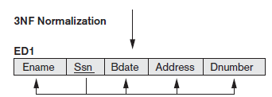

Example 3NF(CO3)
Solution:-
(primary key of relation EMP_DEPT is SSN)
1. The relation schema EMP_DEPT is in 2NF, since no partial dependencies on a key exist.
2. EMP_DEPT is not in 3NF because of the transitive dependency of DMGRSSN (and also DNAME) on SSN via DNUMBER.
(Dnumber is neither key itself nor a RHS of FD has prime attributes. We can see that dependency of {dname,dmgr_ssn} on Dnumber is undesirable.
How to achieve 3NF?
Hence to apply 3NF we need to decompose the relation EMP_Dept and convert them in to 3NF.

Slide 114
Example-2(CO3)
Let us consider following relation schema Lots=
{Property_id, country name,lotno,area, price,tax_rate} and FD Set F=
FD1, property_id ->{Countryname,lotno,area,price,tax_rate}
FD2, {CountryName,Lotno} -> {area,price,tax_rate,property_id}
FD3,Countryname -> tax_rate
FD4, area -> price;
Check for 3NF, if it is not in 3NF then converted into 3NF.
In this relation property_id is primary key and {countryname, lotno} as a candiadate key.

Slide 115
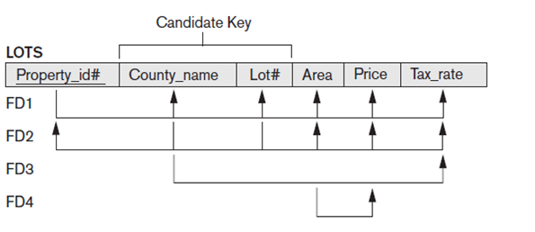

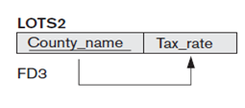
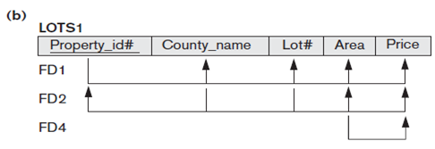
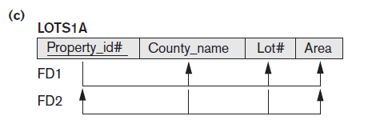
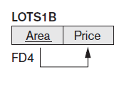
Solution(CO3)
Hence the transitive and partial dependencies that violate 3NF can be removed in any order.

Slide 116
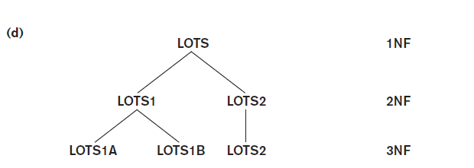
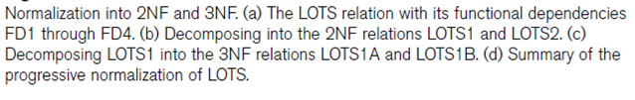
Solution(CO3)

Slide 117
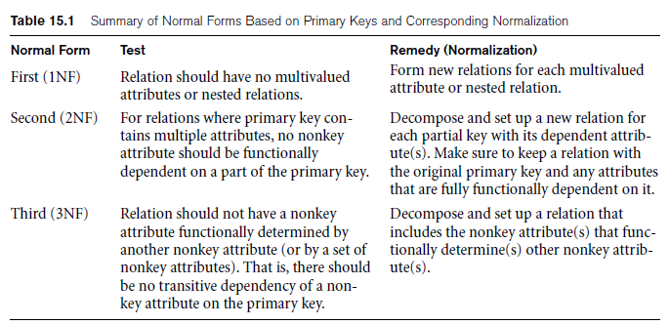
General Definitions of 1NF,2NF and 3NF(CO3)

Slide 118
4. Boyce Codd Normal Form (BCNF) OR 3.5NF (CO3)
Boyce-Codd normal form (BCNF) was proposed as a simpler form of 3NF, but it was found to be stricter than 3NF, because every relation in BCNF is also in 3NF; however, a relation in 3NF is not necessarily in BCNF
The official qualification for BCNF are:-
A relation must be in 3NF.
All determinates are super keys,
if determinates are not super key are removed to placed in another relation.
Definition:- A relation schema R is in Boyce-Codd Normal Form (BCNF) if whenever an FD X -> Y holds in R,
A relation R is in BCNF if every functional dependency X → Y, X is the super key of the Relation.
Means
A relation is in BCNF if every determinants is a super key or candidate key .

Slide 119
Continue….
The formal definition of BCNF differs from the definition of 3NF in that clause (b) of 3NF, which allows functional dependency having the RHS as a prime attribute, is absent from BCNF. That makes BCNF a stronger normal form compared to 3NF.
(LHS of every functional dependency must be super key or candidate key and RHS prime attribute condition not allowed in BCNF)
Note:- Every relation in BCNF is in 3NF,but it is not necessary that every relation in 3NF is in BCNF.

Slide 120
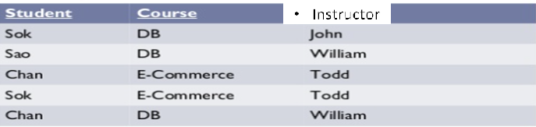
Example
Let us consider the following relation TEACH= {student,Course,Instructor}
with the following dependencies: -
FD1: {Student, Course} → Instructor
FD2: Instructor → Course
{Student, Course}. Check this relation in BCNF or not. is a candidate key for this relation

Slide 121
Example
Instructor is not super keys but determines course. So student relation in 3NF.
But student relation is not in BCNF because in FD Instructor → Course, Instructor is not super key or candidate key or primary key.
Solution :-
Therefore the relation Teach decompose in
1. Teach1 {Student, Instructor}
2. Teach 2 {Instructor, Course}
Teach1 Teach 2

Slide 122

Continue…
All three decompositions will lose functional dependency . We have to settle for sacrificing the functional dependency preservation. But we cannot sacrifice the non-additivity property after decomposition.
Out of the above three, only the 3rd decomposition will not generate spurious tuples after join.(and hence has the non-additivity property).

Slide 123
Multi-valued Dependency(CO3)
Multi-valued dependency (MVD)
Consequence of first normal form (1NF) which diasallow an attribute in a tuple to have a set of values.
A multivalued dependency always requires at least three attributes because it consists of at least two attributes that are dependent on a third attribute .
Let us consider a relation R =(A,B,C) and value of A there is a set of value of B & a set of value of C. However the set of value for B & C are independent of each other.
We write A →→ B and
A →→ C.

Slide 124
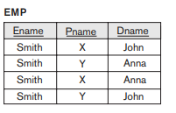
Example
Example :- Employee whose name is ename work on project Pname and has dependent dname. An employee may work on several projects and have several dependents & both project and dependents are independent from each other.
problem
Multivalued dependencies (MVDs) express a condition among tuples of a relation that exists when the relation is trying to represent more than one to many or many to many relationship.

Slide 125
Formal Definition of Multivalued Dependency(CO3)
A multivalued dependency X →→ Y specified on relation schema R, where X and Y are both subsets of R, specifies the following constraint on any relation state r of R:
If two tuples t1 and t2 exist in r such that t1[X] = t2[X], then two tuples t3 and t4 should also exist in r with the following properties,
t1[X] = t2[X] = t3[X] = t4[X]
t1[Y] = t3[Y] and t2[Y] = t4[Y]
t1[Z] = t4[Z] and t3[Z] = t2[Z]
Where X →→ Y holds, we say that X multi-determines Y, or Y is multi-dependent on X.

Slide 126
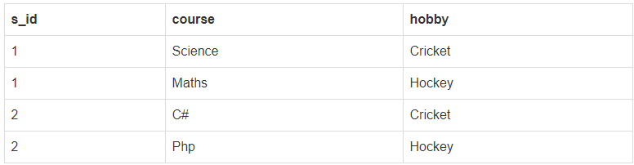
Forth Normal Form (4NF)(CO3)
The official qualification for 4NF are:-
A table is already in BCNF.
A table contain no multi-valued functional dependency .
Example :- Let us consider following relation student:-
Key:- {s_id,course,hobby}
MVD, s_id →→ course,hobby
To check relation is in 4NF or not.

Slide 127
Example
As you can see in the above table , student with s_id 1 has opted for two courses, Science and Maths, and has two hobbies, Cricket and Hockey.
You must be thinking what problem this can lead to, right?
Problem:- Well the two records for student with s_id 1& 2, will give rise to two more records, because for one student, two hobbies exists, hence along with both the courses, these hobbies should be specified.

Slide 128
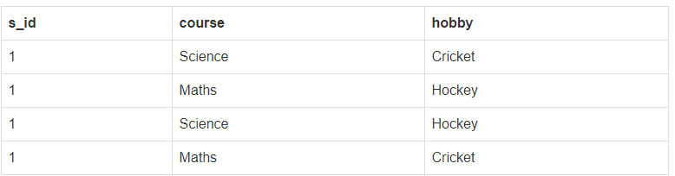
Continue
In the above table , there is no relationship between the columns course and hobby. They are independent of each other.
So there is multi-value dependency, which leads to un-necessary repetition of data and other anomalies as well.

Slide 129

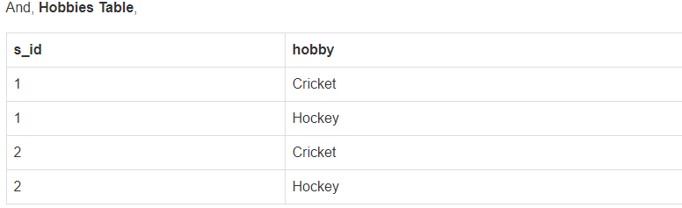
Solution
Solution:- To make the above relation satisfy the 4th normal form, we can decompose the table into 2 tables.
Now this relation satisfies the fourth normal form.

Slide 130
Fifth Normal Form (5NF)(CO3)
The 5NF (Fifth Normal Form) is also known as project-join normal form (PJNF).
A relation is in Fifth Normal Form (5NF), if
it is in 4NF, and
won’t have lossless decomposition into smaller tables.
Definition:- A join dependency (JD), denoted by JD(R1, R2, … , Rn), specified on relation schema R, specifies a constraint on the states r of R.
The constraint states that every legal state r of R should have a non-additive join decomposition into R1, R2, … , Rn.
Hence, for every such r we have * (πR1 (r), πR2 (r), … , πRn (r)) = r

Slide 131
Fifth Normal Form (5NF)(CO3)
5NF is of little practical use to the database designer, but it is of interest from a theoretical point of view.
In all of the further normal forms discussed so far, no loss decomposition was achieved by the decomposing of a single table into two separate tables.
Note :- In considering 5NF, consideration must be given to tables where this non-loss decomposition can only be achieved by decomposition into three or more separate tables.

Slide 132
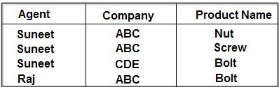
Example
Let us consider the following relation person with attribute ((Agent, Company, Product _Name))
The table is in 4NF because it contains no multi-valued dependency.
It does, however, contain an element of redundancy in that it records the fact that Suneet is an agent for ABC twice. But there is no way of eliminating this redundancy without losing information.

Slide 133
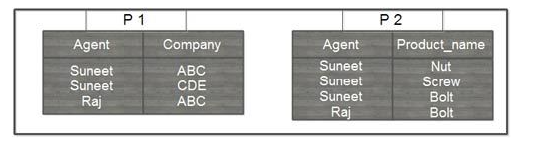
Continue
Suppose that the Relation Person is decomposed into two relation P1 and P2.
The redundancy has been eliminated, but the information about which companies make which products and which of these products they supply to which agents has been lost.

Slide 134
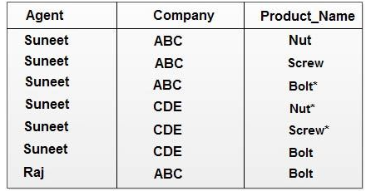
Continue..
The natural join of these projections over the ‘agent’ columns is:
The table resulting from this join is spurious, since the asterisked row of the table contains incorrect information.
Solution :- When we decompose the relation such case common attribute must be a candidate key.

Slide 135
Cont……..
Now suppose that the original table were to be decomposed into three tables, the two projections, P1 (agent,company)and P2(agent,procduct) which have already shown, and the final, possible projection, P3 (company,product). P3
Company | Product_name
ABC | Nut
ABC | Scew
CDE | Bolt
ABC | Bolt

Slide 136
Conti….
If a join is taken of all three projections, first of P1 and P2 with the (spurious) result shown above, and then of this result with P3 over the ‘Company’ and ‘Product name’ column, the following table is obtained:-
This still contains a spurious row. The order in which the joins are performed makes no difference to the final result. It is not simply possible of decompose the ‘AGENT_COMPANY_PRODUCT’ table, populated as shown, without losing information. Thus, it has to be accepted that it is not possible to eliminate all redundancies using normalization techniques, because it cannot be assumed that all decompositions will be non-loss.
Agent | Company | Product_Name
Suneet | ABC | Nut
Suneet | ABC | Screw
Suneet | ABC | Bolt
Suneet | CDE | Bolt
Raj | ABC | Bolt

Slide 137
SUMMARY 1-5 NF
Overall Steps that can be done to achieve Normalization:
Remove repeating groups or to eliminate repeating groups.
Eliminate or remove repeating data.
Remove those columns that are not dependent on Key.
Multiple relationship should be isolated independently.
Isolate Semantically Related Multiple Relationships

Slide 138
Sixth Normal Form- DKNF (6NF)
The basic idea behind the DKNF (Domain key normal form) is to specify the normal form that takes into account all the possible dependencies and constraints.
DKNF is a normal form used in database normalization which requires that the database contains no constraints other than domain constraints and key constraints.
OR
A relation schema is said to be in DKNF only if all the constraints and dependencies that should hold on the valid relation state can be enforced simply by enforcing the domain constraints and the key constraints on the relation.

Slide 139
Sixth Normal Form- DKNF (6NF)
Reason to use DKNF are as follows:
To avoid general constraints in the database that are not clear key constraints.
Most database can easily test or check key constraints on attributes.
However, because of the difficulty of including complex constraints in a DKNF relation its practical utility is limited means that they are not in practical use, since it may be quite difficult to specify general integrity constraints.
Let’s understand this by taking an example:
Consider relations CAR (MAKE, vin#) and MANUFACTURE (vin#, country), Where vin# represents the vehicle identification number ‘country’ represents the name of the country where it is manufactured. A general constraint may be of the following form: If the MAKE is either ‘HONDA’ or ‘MARUTI’ then the first character of the vin# is a ‘B’ If the country of manufacture is ‘INDIA’ If the MAKE is ‘FORD’ or ‘ACCURA’, the second character of the vin# is a ‘B” if the country of manufacture is ‘INDIA’. There is no simplified way to represent such constraints short of writing a procedure or general assertion to test them. Hence such a procedure needs to enforce an appropriate integrity constraint. However, transforming a higher normal form into domain/key normal form is not always a dependency-preserving transformation and these are not possible always.

Slide 140
Sixth Normal Form- DKNF (6NF)
Advantages of Domain Key Normal Form:
Improved Data Integrity
Reduced Data Redundancy
Improved Query Performance
Easier Maintenance and Updates
Better Flexibility
Disadvantage of Domain Key Normal Form:
Increased Complexity
Costly
Reduced Performance
Limited Scalability

Slide 141
Content
Lecture 8:-
Decomposition of relation Schema
Properties of decomposition

Slide 142
Decomposition of relation Schema(CO3)
Decomposition of relation schema R consists of replacing the relation schema by two or more sub relations schemas. So that each contain subset of attributes of relation schema R and which together include all attribute or R.
Decomposition of relation R= {A1,A2,A3,…….An} is the replacement of R by a collection D={R1,R2…….Rm} where Ri is subset of R such that R={ R1 U R2 U…….RN}
Example :- R= { Eid,position,salary}
D1= {Eid,position}
D2= {Postion,Salary}
Using the functional dependencies we can decompose a given relation schema R= {A1,A2,……AN} into a set of relation schema represented by D={R1,R2…..RN} to remove anomalies present in a database(Relations).

Slide 143
Properties of decomposition(CO3)
There are three properties of decomposition of relation are
Attribute Preservation
Dependency Preservation
Lossless Join decomposition

Slide 144
Attribute Preservation(CO3)
We must make sure that each attribute in R will appear in at least one relation schema Ri in the decomposition so that no attributes are lost; formally, we say this is called attribute preservation.
Example :- R={A,B,C,D,E,F}
Decompose relation are
R1={A,B,C,D}
R2={A,E,F}
Note :- Union of all decompose relation will give all attribute of universal relation R.
R1 U R2= R{A,B,C,D,E,F}.

Slide 145
2. Dependency Preservation(CO3)
It would be useful if each functional dependency X → Y specified in F either appeared directly in one of the relation schemas Ri in the decomposition D or could be inferred from the dependencies that appear in some Ri. Informally, this is the dependency preservation condition.
We want to preserve the dependencies because each dependency in F represents a constraint on the database. If one of the dependencies is not represented in some individual relation Ri of the decomposition, we cannot enforce this constraint by dealing with an individual relation.

Slide 146
Cont….. (CO3)
If we decompose a relation R into relations R1 and R2, All dependencies of R either must be a part of R1 or R2 or must be derivable from combination of FD’s of R1 and R2.
A Decomposition D = { R1, R2, R3….Rn } of R is dependency preserving write E a set F of Functional dependency if
(F1 ∪ F2 ∪ … ∪ Fm) ⁺ = F⁺ .

Slide 147
Example
Question 1 :- Let a relation R (A, B, C, D ) and functional dependency {AB –> C, C –> D, D –> A}. Relation R is decomposed into R1( A, B, C) and R2(C, D).
Check whether decomposition is dependency preserving or not.
Question 2:- Let us consider a relation R (A, B, C, D,E,F ) with functional dependency set F= {D –> AB, C–> EF,}and relation R is decomposed into R1( A,C,D), R2(A,D,B), R3(D,E,F), R4(C,E,F).
Check whether decomposition is dependency preserving or not.

Slide 148
Nonadditive (Lossless) Join Property of a Decomposition(CO3)
Another property that a decomposition D should possess is the nonadditive join property, which ensures that no spurious tuples are generated when a NATURAL JOIN operation is applied to the relations resulting from the decomposition.
Definition. Formally, a decomposition D = {R1, R2, … , Rm} of R has the lossless (nonadditive) join property with respect to the set of dependencies F on R if, for every relation state r of R that satisfies F, the following holds, where * is the NATURAL JOIN of all the relations in D: *(πR1(r), … , πRm(r)) = r.

Slide 149
Procedure(CO3)
Procedure :- Decomposition of R into R1 and R2 from a lossless join decomposition if at least one of the following dependencies in F⁺
First condition) = (ABC) U (AD) = (ABCD) = Att(R). holds true as Att(R1) U Att(R2
R1 ∩ R2= R1 , that is: all attributes common to both R1 and R2 functionally determine ALL the attributes in R1.
OR
R1 ∩ R2= R2 that is: all attributes common to both R1 and R2 functionally determine ALL the attributes in R2
3. In other word R1 ∩ R2 from a super key or candidate key of either R1 or R2 or both , The decomposition of R is a lossless join decomposition.

Slide 150
Example
Question 1 :- Let a relation R (A, B, C, D ,E) and functional dependency {A –> BC, CD –> E, B –> D, E> A}.
Relation R is decomposed into R1( A, B, C) and R2(A, D,E).
Check whether decomposition is lossless or lossy decomposition.
Question 2 :- Let a relation R (A,B,C,D,E,F) and functional dependency {AB –> C, C –> D, D –> EF, F -> A,D ->B}.
Relation R is decomposed into R1( A,B,C) , R2(C,D,E),R3(E,F).
Check whether decomposition is lossless or lossy decomposition.

Slide 151
Testing for Non additive join property
A Universal relation R , decomposition D {R1,R2,……Rm} of R and a set of Functional dependencies
Step 1:- Create a matrix by the given set of FD’s (initially matrix will one row i for each relation Ri in D, and one column J for each attribute Aj in R ).
Step 2:- Set s(i,j) = by for all matrix entries:-
Put the symbol ‘a’ for those element which are present in the given set D. And
Put the symbol ‘b’ for those element which are not present in the given set D.
Setp3:- Now apply the given FD’s and developed new matrix by changing the symbol ‘b’ to ‘a’ if the element functionally dependent.
Step 4:- Check whether any raw is filled with all ‘a’.
Step 5:- if any raw is filled with all ‘a’ element then It is lossless join decomposition otherwise lossy decomposition.

Slide 152
Example
Question 1:- Let us consider a relation Schema R ={SSN, PNumber, PName, PLocation,Hours} and functional dependency set f=
SSN –> Ename,
Pnumber –> {Pname,Plocation}
{SSN,Number} –> Hours } and
Decompose a relation D = {R1,R2,R3} where R1= {SSN, Ename}, R2= {Pnumber, Pname,Plocation} and R3= {SSN, Pnumber, Hours} .
show whether decomposition is lossy or lossless join decomposition .

Slide 153
Question 2:- Let us consider a relation Schema R ={A,B,C,D,E,} and functional dependency set f=
AB –> CD,
A –> E
C –> D } and
Decompose a relation D = {R1,R2,R3} where R1= {A,B,C}, R2= {B,C,D}, and R3= {C,D,E} .
show whether decomposition is lossy or lossless join decomposition .

Slide 154
Inclusion Dependencies(CO3)
MVDs and JDs can be used to guide database design, as we have seen, although they are less common than FDs and harder to recognize and reason about.
In contrast, inclusion dependencies are very intuitive and quite common. However, they typically have little influence on database design
The main point to bear in mind is that we should not split groups of attributes that participate in an inclusion dependency.
Most inclusion dependencies in practice are key-based, that is, involve only keys.

Slide 155
Faculty Video Links, Youtube & NPTEL Video Links and Online Courses Details
Youtube/other Video Links
https://www.youtube.com/watch?v=1yUkun2r0N4
https://www.youtube.com/watch?v=EFdvRm5nse0

Slide 156
Daily Quiz
What is functional dependency?
Explain normal forms.
What is multi valued dependency?
Explain BCNF.
Explain redundancy.

Slide 157
Quiz
Question 1:- When you normalize a relation by breaking it into two smaller relations, what must you do to maintain data integrity?
Please select all the correct answers.
A. Link the relations by a common field
B.Remove any functional dependencies from both relations
C .Assign both relations the same primary key field(s)
D .Create a primary key(s) for the new relation
Question 2:- A relation is in 1NF if it doesn't contain any ____________?
A. Determinants
B. Repeating groups
C. Null values in primary key fields
D. Functional dependencies

Slide 158
Quiz
Question 3:A functional dependency that exist between two non-key attributes is called _____
(a) Non-transitive dependency (b) Transitive dependency
(c) Partial transitive dependency (d) None of the above
Question 4:-In the __________ normal form, a composite attribute is converted to individual attributes. a) First b) Second c) Third d) Fourth

Slide 159
Daily Quiz
Relation R has eight attributes ABCDEFGH. Fields of R contain only atomic values. F = {CH -> G, A -> BC, B -> CFH, E -> A, F -> EG} is a set of functional dependencies (FDs) so that F+ is exactly the set of FDs that hold for R. How many candidate keys does the relation R have? Gate 2013
Answer: (B) Explanation: A+ is ABCEFGH which is all attributes except D.
B+ is also ABCEFGH which is all attributes except D.
E+ is also ABCEFGH which is all attributes except D.
F+ is also ABCEFGH which is all attributes except D.
So there are total 4 candidate keys AD, BD, ED and FD

Slide 160
Glossary Questions
1. What are advantages and disadvantages of Distributed DBMS.
2. What are the features of DDBMS?
3. Explain the basic Timestamp Ordering Algorithm.
4. What are the objectives of Distributed Query Processing?
5. What is horizontal and vertical fragmentation? What are the types of horizontal fragmentation. Perform horizontal Fragmentation for student relation as given below. Also give the corrextness criteria for it. Students (studentrollno., Student Name, Course Name, Course Name, Course fees, year)
6. What are the various kinds of transparencies in distributed database design? Explain each with the help of example.

Slide 161
Weekly Assignment
What do you mean by BCNF ? Why it is used and how it differ from 3 NF ? CO3
Discuss the various normal forms in normalization with suitable examples? Why is concurrency control needed? Explain lost update, Inconsistent retrievals and uncommitted dependency anomalies. CO3
Explain the Codd’s Rule in detail. CO3
Explain Normalization with example. CO3
What are the rules of 1NF,2NF,3NF. CO3
Discuss Boyce Codd Normalization Form. CO3

Slide 162
MCQ s
Which forms simplifies and ensures that there are minimal data aggregates and repetitive groups: a) 1NF b) 2NF c) 3NF d) All of the mentioned
For any pincode, there is only one city and state. Also, for given street, city and state, there is just one pincode. In normalization terms, empdt1 is a relation in a) 1 NF only b) 2 NF and hence also in 1 NF c) 3NF and hence also in 2NF and 1NF d) BCNF and hence also in 3NF, 2NF and 1NF

Slide 163
MCQ s
In the __________ normal form, a composite attribute is converted to individual attributes. a) First b) Second c) Third d) Fourth
Functional Dependencies are the types of constraints that are based on______ a) Key b) Key revisited c) Superset key d) None of the mentioned

Slide 164
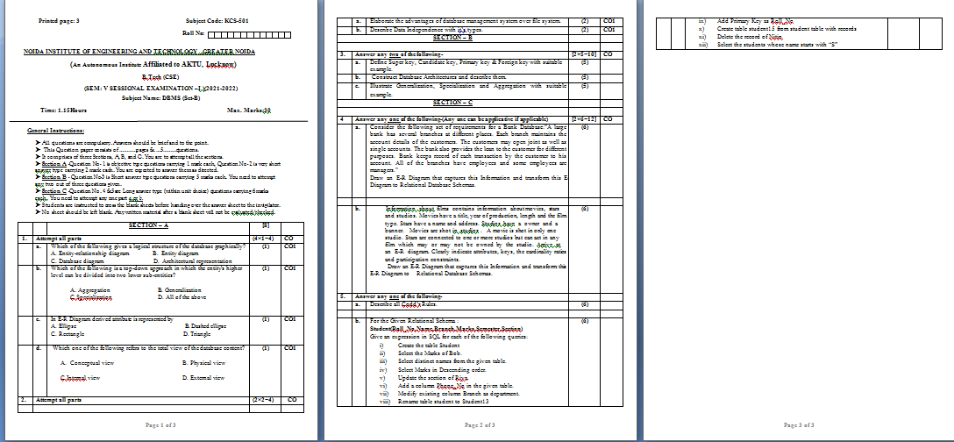
Sessional paper Template

Slide 165
Old Question Papers
http://www.aktuonline.com/papers/btech-cs-5-sem-data-base-management-system-rcs501-2020.pdf
http://www.aktuonline.com/papers/btech-cs-5-sem-database-management-system-KCS501-2018-19.pdf
http://www.aktuonline.com/papers/btech-cs-5-sem-database-management-system-ncs-502-2017-18.pdf
http://www.aktuonline.com/papers/btech-cs-5-sem-database-management-system-ncs-502-2016-17.pdf

Slide 166
Expected Questions for University Exam
Explain normalization. What is normal form?
Describe the following terms :
(i) Multivalued dependency
(ii) Trigger
Why do we normalize database?
Define partial functional dependency. Consider the following two sets of functional dependencies F= {A ->C, AC ->D, E ->AD, E ->H} and G = {A ->CD, E ->AH}. Check whether or not they are equivalent.
What is Trigger? Explain different trigger with example.
Write difference between BCNF Vs 3 NF.

Slide 167
Recap of Unit
Knowledge of database design.
Knowledge of functional dependencies.
Knowledge of Normal forms.
Knowledge of Loss less join decomposition, Multivalued dependency and join dependency

Slide 168
Faculty Video Links, Youtube & NPTEL Video Links and Online Courses Details
You tube /other Video Links
https://nptel.ac.in/courses/106/104/106104135/
https://nptel.ac.in/courses/106106220/
https://www.youtube.com/watch?v=1057YmExS-I

Slide 169
References
Korth, Silbertz, Sudarshan,” Database Concepts”, McGraw Hill
Date C J, “An Introduction to Database Systems”, Addision Wesley
Elmasri, Navathe, “ Fundamentals of Database Systems”, Addision Wesley
O’Neil, Databases, Elsevier Pub.
RAMAKRISHNAN"Database Management Systems",McGraw Hill
Leon &Leon,”Database Management Systems”, Vikas Publishing House
Bipin C. Desai, “ An Introduction to Database Systems”, Galgotia Publications
Majumdar& Bhattacharya, “Database Management System”, TMH
R.P. Mahapatra, Database Management System, Khanna Publishing House

Slide 170
Thank You

